Slide 1
Computer parts
By Nathaniel Sturm

Slide 2
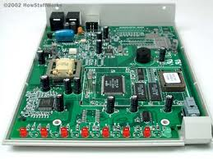
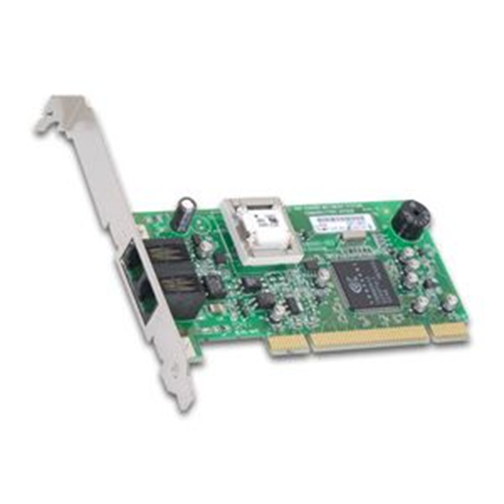
Internal modem
where the computer is connected to a phone line

Slide 3
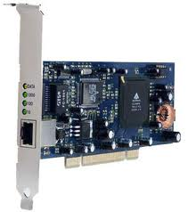
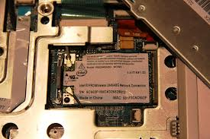
Network card
A circuit board that connects the computer to the network using special cables.

Slide 4
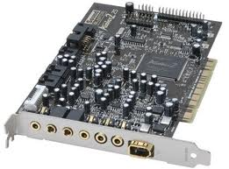
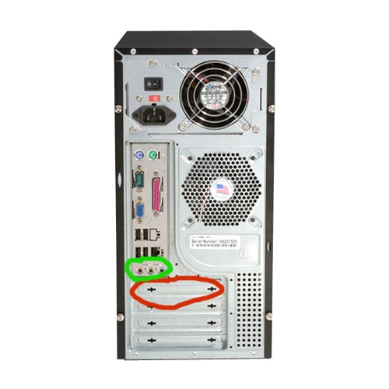
Sound card
Connects the speakers microphone headphones to the computer

Slide 5
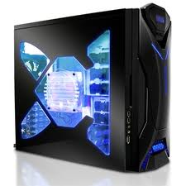
Computer case
It helps protect major components of the computer.

Slide 6
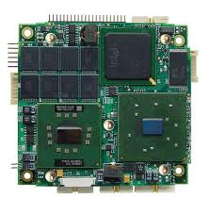
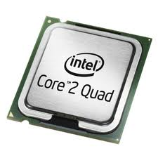
CPU
The Central Processing Unit

Slide 7
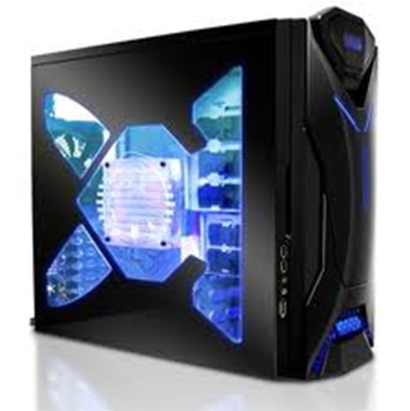
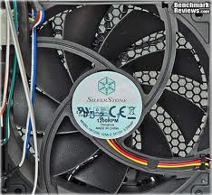
Fan connected to the case
It keeps the computer from over heating

Slide 8
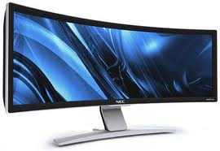
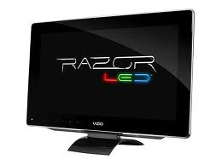
monitor
A screen to provide “output” to the user. It is where you view the stuff that you are working on

Slide 9
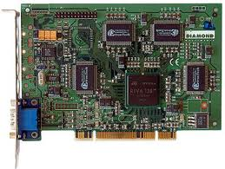
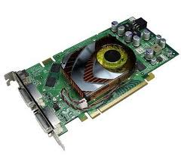
Video card
Connects the computer to the monitor it’s a circuit board that’s attached to the motherboard.

Slide 10
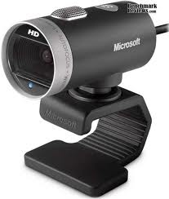
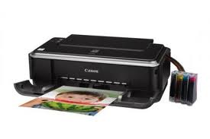
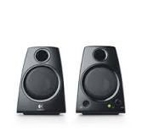
Output: printer, webcam, speakers
Printer it prints things
Webcam lets you see people from different places
Speakers generate sound or noise

Slide 11
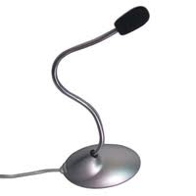
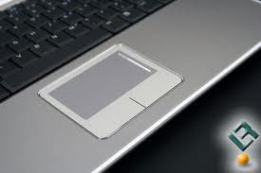
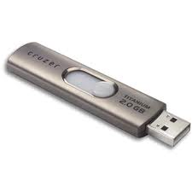
Input:
Mircophone it records your sound
Touchpad a replacement of the mouse
Flashdrive inputs information into the computer

Slide 12
Software
windows
Microsoft
Battlefield 3

Slide 13
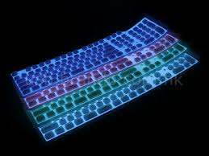
keyboard
It inputs the letter that you push down on the keyboard

Slide 14
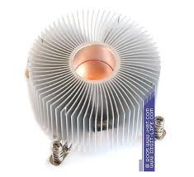
heatsink
It cool the computer

Slide 15
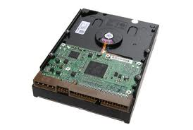
harddrive
Storage device

Slide 16
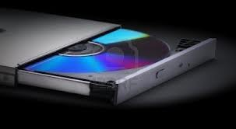
CD DRIVE/BLUE RAY/ODR
It plays disks

Slide 17
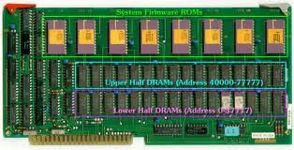
RAM/ROM
Ram is random access activity
rom is temporary memory

Slide 18
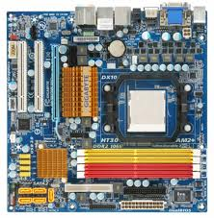
Mother board
Were a lot of the electornic stuff is
located

Slide 19
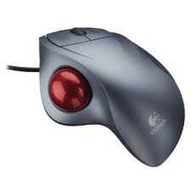
Mouse
It moves the cursor to click on programs

